Slide 1
Chapter 1 - Arrays & Strings
Learning outcomes:
Describe the idea of an array
Apply declaration & initialization of arrays
Perform accessing elements of an array
Discuss & create multi-dimensional arrays
Describe C++ string representation
Apply declaration & initialization of string
Practice reading strings from the keyboard
Evaluate C++ standard library for string

Slide 2

Introduction
Array
a group of elements of the same type placed in contiguous memory locations,
under one common name or (same name).
e.g., array mark to contain 5 integer values:
First: index=0, Last: index=N-1, where N is the array size.
an array must be declared before it is used.
index
mark
int

Slide 3
Declaring Array
Declaring array variable,
type of array (e.g, int, char, float…etc.)
variable name (identifier)
number of elements (size)
Syntax: type arrayName[arraySize];
e.g., int mark[5]; // declare mark, an array of 5 integers
Declaring multiple arrays of same type,
e.g., int a[100], b[27], c[10]; // use comma separated list

Slide 4
Cont’d…
Regular arrays are blocks of non-dynamic memory:
static entity (or have the same size throughout the program)
its size must be determined when declared (before execution)
Regular arrays (“arrays of known constant size”):
size can be specified by a constant integer variable
e.g., const int size=20; //size cannot be changed
int x[size];
constant variables must be initialized when declared

Slide 5

Initializing Arrays
Specify each element values when array declared,
e.g., int mark [5]={10, 25, 30, 14, 50}; // initialize mark
When not enough initializers, sets all rightmost elements
e.g., int n[5]= {0}; // sets every element to 0
When array size is omitted, array size = number of initializers
int n[]={1, 2, 3, 4, 5}; // n has an array size of 5
mark

Slide 6
Accessing Array Elements
To refer to array element,
specify array name and index
Syntax: arrayName[index]
Array c with N-element: c[0], c[1]… c[n-1]
first element: index=0; the N^{th} element: index=N-1
E.g., array int mark[5],
mark[0]; mark[1];...mark[4];

Slide 7
Cont’d…
Trying to access mark[5], you may encounter
“undefined behavior” (program can crash, freeze, random output …etc.)
Like other variables, array elements can be:
assigned or printout values
e.g., mark[1]=75; cout<<mark[1];
or perform operations (inside the subscript)
e.g., int a=1; mark[a]=75;
int b; b=mark[a+2]; // same as b=mark[3]
mark [mark[a]]= mark[2] + 5;

Slide 8
Cont’d…
To read or write to/from an array,
often use for loop control structure
E.g., for reading values from array mark[5]
for(int i=0; i<5; i++)
cout<<mark[i]; // to write cin>>mark[i];
Often format I/O stream,
using stream manipulators in <iomanip>
e.g., setw() // for setting field widths
Note: No Array-to-Array Assignments, No Bounds Checking

Slide 9
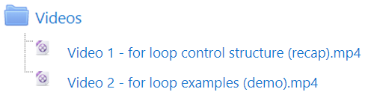
Activity 0 - Watch videos!
Instruction:
Please login to your Moodle¹ course page to complete this activity.
¹ https://elearning.amu.edu.et/

Slide 10
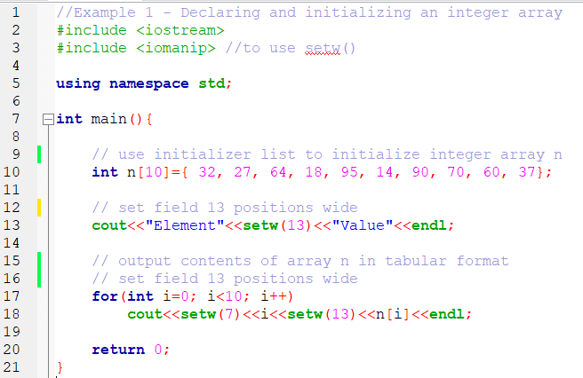
Example 1

Slide 11
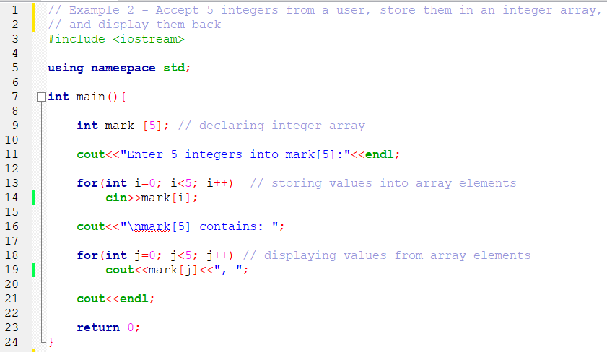
Example 2

Slide 12
Multi-dimensional Arrays
One dimensional (1D) arrays
e.g., int x[10], char y[5]…etc.
Multidimensional arrays (“arrays of arrays”)
e.g., int a[3][4], … a[i][j]…[n]
Most common: two dimensional (2D) arrays
e.g., a[i][j] // have two subscripts
can be considered as a table: rows & columns
i specify row, j specify column

Slide 13
Cont’d…
To declare
e.g., int x[3][4];
referred as a “3 by 4” integer array
the size of array x will be 3*4=12 elements
Column 0
Column 1
Column 2
Column 3
Row 0
a[0][0]
a[0][1]
a[0][2]
a[0][3]
Row 1
a[1][0]
a[1][1]
a[1][2]
a[1][3]
Row 2
a[2][0]
a[2][1]
a[2][2]
a[2 ][3]
Column subscript
Array name
Row subscript

Slide 14
Cont’d…
To initialize
initializers are grouped by row in braces
e.g., int a[2][2]={{1,2},{3,4}};
int b[][2]={{1},{3,4}};
Referenced like array variable
cout<<b[0][1]; // the default is 0; outputs 0
cout<<b[][1]; // error message
a
1 2
3 4
Row 0
Row 1
b
1 0
3 4

Slide 15
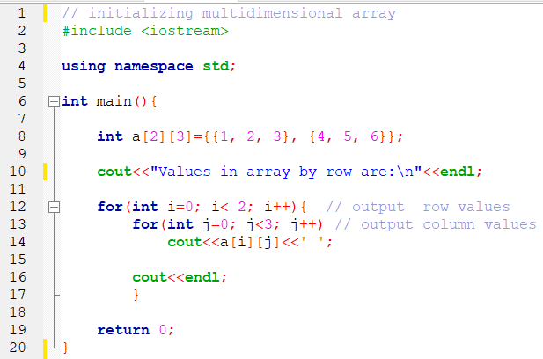
Example 3

Slide 16
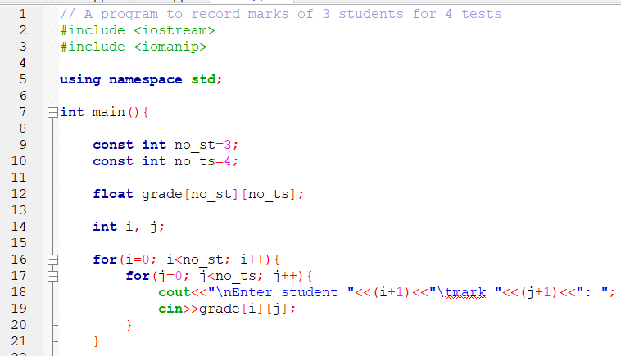
Example 4

Slide 17
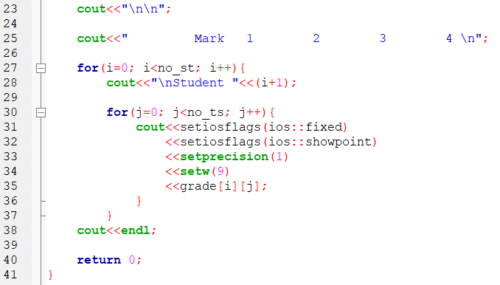
Cont’d…

Slide 18
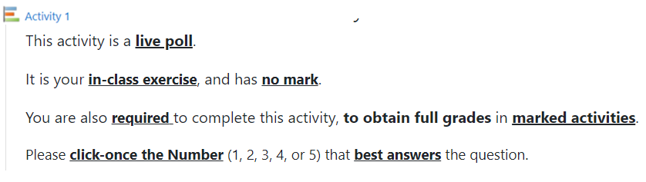
Activity 1 – Live poll!
Instruction:
Please login to your Moodle¹ course page to complete this activity.
1 https://elearning.amu.edu.et/

Slide 19
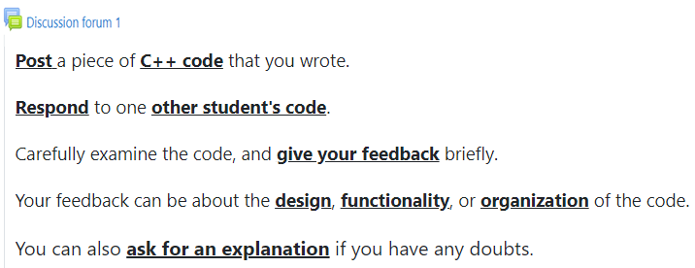
Discussion forum 1 – Hands-on exercise!
Instruction:
Please login to your Moodle¹ course page to complete this activity.
1 https://elearning.amu.edu.et/

Slide 20
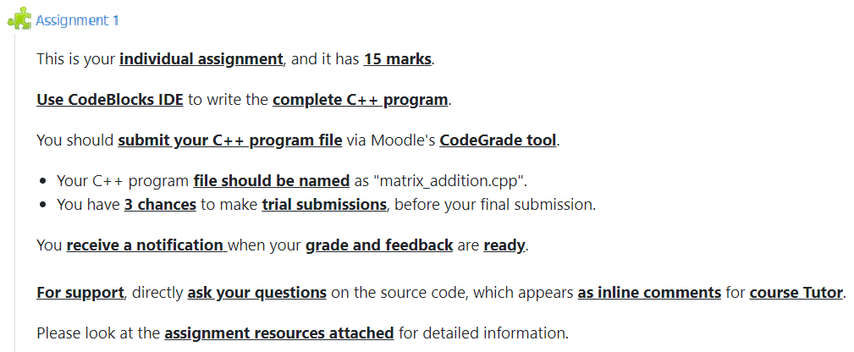
Assignment 1 – Individual assignment!
Instruction:
Please login to your Moodle¹ course page to complete this activity.
1 https://elearning.amu.edu.et/

Slide 21
C++ Strings
Recap: character constant, placed in single quotes (‘ ’)
e.g., char x='z'; // 'z' is the integer value of z, 122 in ASCII
letters (a-z), digits (0-9), symbols (*), non-printable (enter or ‘\n’)
String
a series of characters, treated as single unit
e.g., name of a person
String constant, placed in double quotes (" ")
e.g., "abebe"

Slide 22
Cont’d…
String (c-style)
“…can be stored in an array of characters” (Bjarne S.)
i.e., NO need for a ‘string’ keyword
To declare
e.g., char name[6]; // no declare array of 6 characters
To initialize
e.g., char name[6]= "abebe"; // initialize a string name
Others: character pointer or C++ ‘string’ keyword (next chapters)

Slide 23
String Initialization
Initialization
e.g., char color[5]="blue";
create char array color with 5 elements
add NULL ('\0') character at the end (color[4])
Alternatively,
e.g., char color[]={‘b’, ‘l’, ‘u’, ‘e’, ‘\0’};
String
an array of characters, NULL ('\0’) terminated.

Slide 24
Accessing Strings
Individual element,
e.g., color[0]=‘c’; // assign c to color[0]
cout<<color[2]; // output u
Entire string
e.g., cout<<color; // output clue
print the characters until NULL is found
caution: do not work for other array types (e.g., int)

Slide 25
Cont’d…
Input from keyboard,
e.g., char str[5]; // declare char array str
cin>>str; // accept 5 characters
cin>> stops at the first whitespace (or blank space)
add NULL ('\0') character implicitly
Input string exceed array size,
modern C++: cin>> accept string above 5 char
i.e., by getting some memory overwritten
solution: cin>>setw(5)>>str; // setw()discard extra chars

Slide 26
Cont’d…
Input string with blank space,
use cin.get(array, size/cin.getline(array, size)
cin.getline()// used later in file I/O operation (CH-6)
e.g., cin.getline(array, size, delimiter);
Stops either delimiter character is entered
or size-1 character limit is reached
E.g., to input a poem
char poem[80];
cin.getline(poem, 80, ‘*');

Slide 27
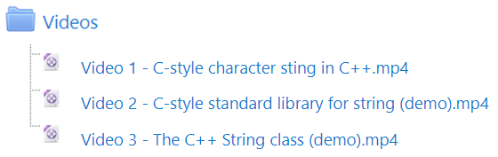
Activity 0 - Watch videos!
Instruction:
Please login to your Moodle¹ course page to complete this activity.
¹ https://elearning.amu.edu.et/

Slide 28
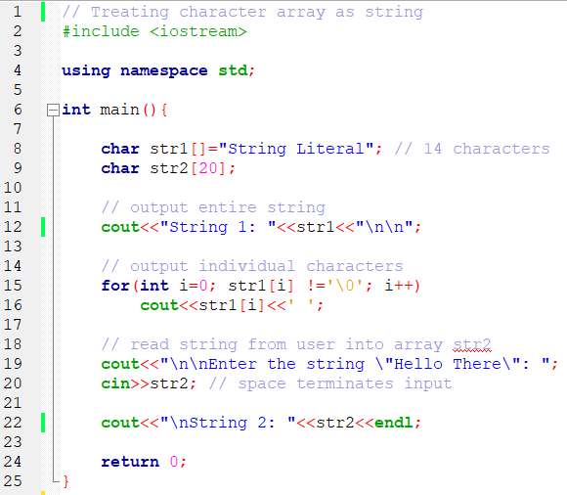
Example 1

Slide 29
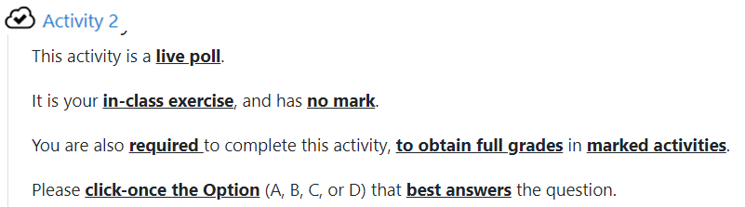
Activity 2 – Live poll!
Instruction:
Please login to your Moodle¹ course page to complete this activity.
1 https://elearning.amu.edu.et/

Slide 30
Standard Library Functions for String
Modern C++ also support C standard library functions,
defined in <cstring>, for string manipulation
Most commons, e.g.,
strcpy() // copy string
strcat() // concatenate strings
strcmp() // compare strings
Strtok() // tokenize string
strlen() // get string length

Slide 31
Cont’d…
char *strcpy( char *s1, const char *s2 ); | Copies the string s2 into the character array s1. The value of s1 is returned.
char *strncp( char *s1, const char *s2, size_t n ); | Copies at most n characters of the string s2 into the character array s1. The value of s1 is returned.
char *strcat( char *s1, const char *s2 ); | Appends the string s2 to the string s1. The first character of s2 overwrites the terminating null character of s1. The value of s1 is returned.
char *strncat( char *s1, const char *s2, size_t n ); | Appends at most n characters of string s2 to string s1. The first character of s2 overwrites the terminating null character of s1. The value of s1 is returned.
int strcmp( const char *s1, const char *s2 ); | Compares the string s1 with the string s2. The function returns a value of zero, less than zero or greater than zero if s1 is equal to, less than or greater than s2, respectively.

Slide 32
Cont’d…
int strncmp( const char *s1, const char *s2, size_t n ); | Compares up to n characters of the string s1 with the string s2. The function returns zero, less than zero or greater than zero if s1 is equal to, less than or greater than s2, respectively.
char *strtok( char *s1, const char *s2 ); | A sequence of calls to strtok breaks string s1 into “tokens”—logical pieces such as words in a line of text—delimited by characters contained in string s2. The first call contains s1 as the first argument, and subsequent calls to continue tokenizing the same string contain NULL as the first argument. A pointer to the current token is returned by each call. If there are no more tokens when the function is called, NULL is returned.
size_t strlen( const char *s ); | Determines the length of string s. The number of characters preceding the terminating null character is returned.

Slide 33
String Copy
char *strcpy(char *s1, const char *s2)
copy string s2 to s1, plus the NULL character
s1 must be large enough to hold s2, plus the NULL character
return the value of s1
char *strncpy(char *s1, const char *s2, size_t n)
copy the first n number of characters of s2 to s1
do not copy NULL character necessarily
append NULL character at the end of s1
return the value of s1

Slide 34
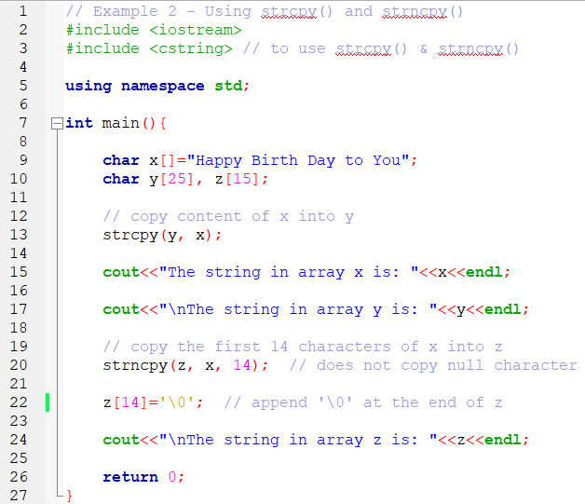
Example 2

Slide 35
String Concatenation
char *strcat(char *s1, const char *s2)
append the copy of s2 to s1, plus the NULL character
the first character of s2 replaces the NULL character of s1
s1 must be large enough to hold s2, plus the NULL character
return the value of s1
char *strncat(char *s1, const char *s2, size_t n)
append the first n number of characters of s2 to s1
plus append NULL character at the end s1
return the value of s1

Slide 36
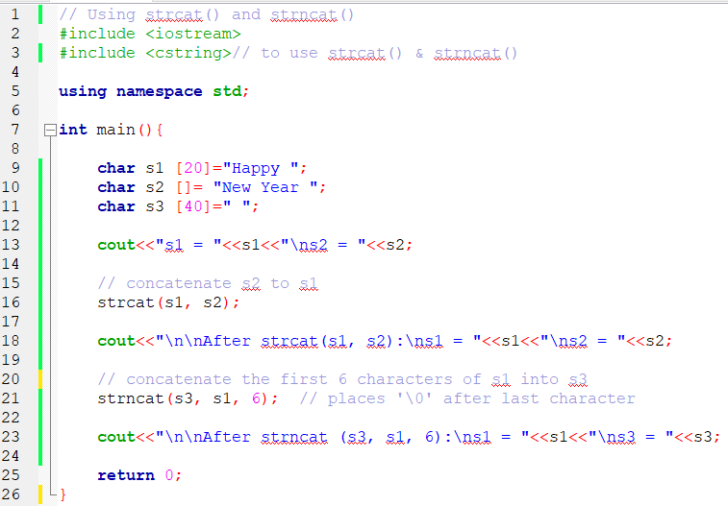
Example 3

Slide 37
String Comparison
Characters are represented as numeric codes
strings are compared using numeric codes of characters
Character codes (character sets)
ASCII (American Standard Code for Information Interchange)¹
e.g., ASCII code for 'z’ is 122, and 90 for ‘Z’ (in decimal)
EBCDIC (Binary Coded Decimal Interchange Code)²
Both represent a character by 8-bits (i.e., 1 byte of memory)
¹ https://theasciicode.com.ar/
² https://en.wikipedia.org/wiki/EBCDIC

Slide 38
Cont’d…
int strcmp(const char *s1, const char *s2)
compare string s1 against s2, character by character
performs a binary comparison of the characters
return:
zero (0), if s1 = s2
negative value (-ve), if s1 < s2
positive value (+ve), if s1 > s2
int strncmp(const char *s1, const char *s2, size_t n)
compare up to n number of characters of s1 against s2

Slide 39
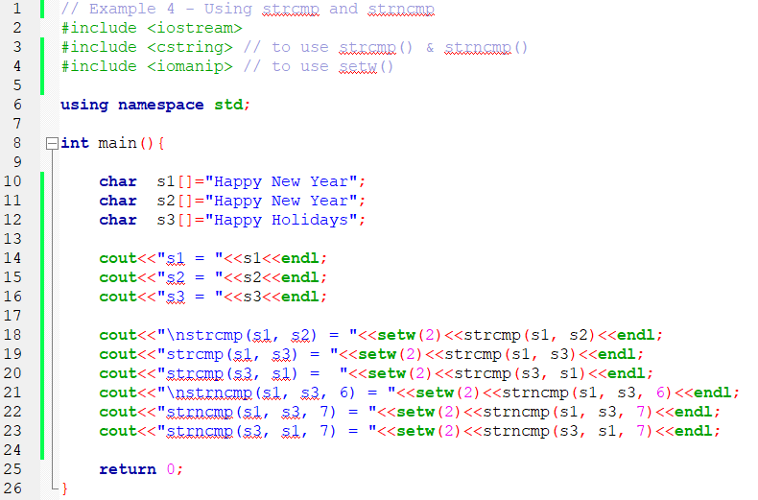
Example 4

Slide 40
String Tokenizing
Tokenizing
break a string into tokens, separated by delimiting characters
tokens usually are logical units, e.g., words separated by “ ”
"This is my string“ = has 4 word-tokens
char *strtok(char *s1, const char *s2)
requires multiple function calls:
1st call, strtok(s1, delimiter)
replace the first delimiter character of string s1 by NULL
subsequent calls, strtok(NULL, delimiter)
continue tokenizing the rest of string s1

Slide 41
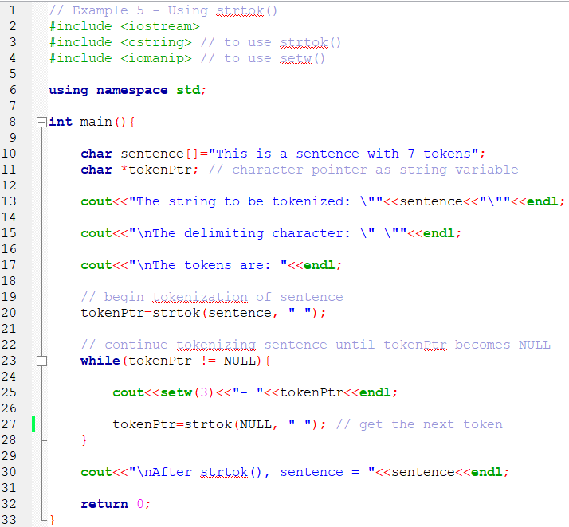
Example 5

Slide 42
String Length
size_t strlen(const char *s)
return the number of characters in a string (i.e., an integer value)
length not include the NULL character
Examples:
char name[]="abebe";
name has a length of 5 (chars)
char str[100]="test string";
str has a length of 11 (chars) // do not confuse with size of str

Slide 43
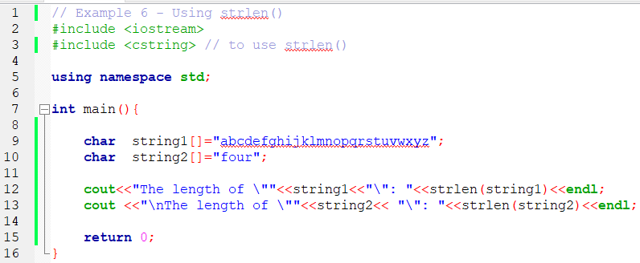
Example 6

Slide 44
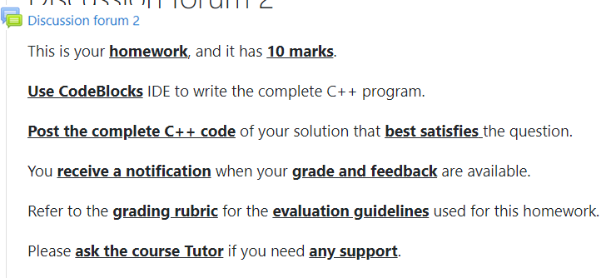
Discussion forum 2 – Homework!
Instruction:
Please login to your Moodle¹ course page to complete this activity.
1 https://elearning.amu.edu.et/

Slide 45
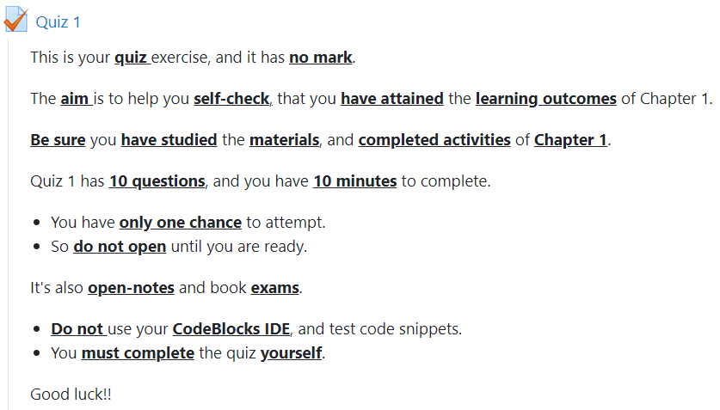
Quiz 1 – Self-evaluation!
Instruction:
Please login to your Moodle¹ course page to complete this activity.
1 https://elearning.amu.edu.et/

